Slide 1
Data Link
Control
and
Protocols

Slide 2
Data Link Control
Framing
Flow Control
Error Control
Protocols(software)

Slide 3
Framing
Data bits packed into frames
separates a message from other by adding sender and destination address.
Can be fixed size (e.g. ATM ) or
variable size framing (e.g. LAN)
Start and end of frame need to define
Character oriented and bit oriented protocol

Slide 4

Note:
Flow control refers to a set of procedures used to restrict the amount of data that the sender can send before waiting for acknowledgment.

Slide 5
Note:
Error control in the data link layer is based on automatic repeat request, which is the retransmission of data.

Slide 6
Stop-and-Wait ARQ
Operation
Bidirectional Transmission

Slide 7
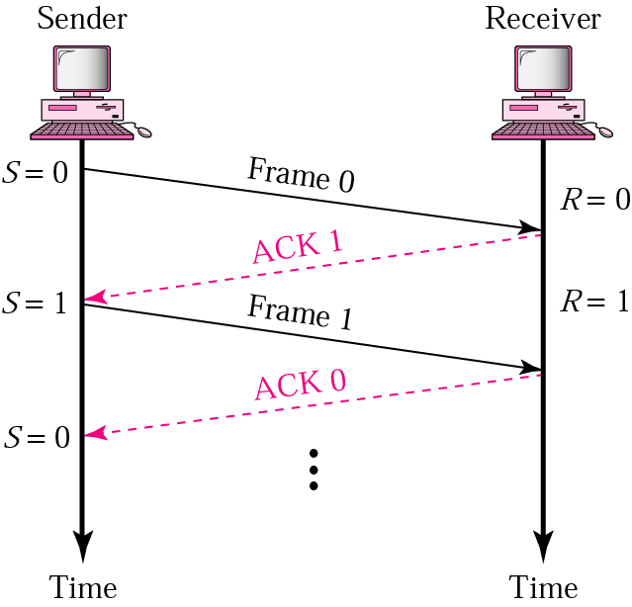
11.1 Normal operation

Slide 8
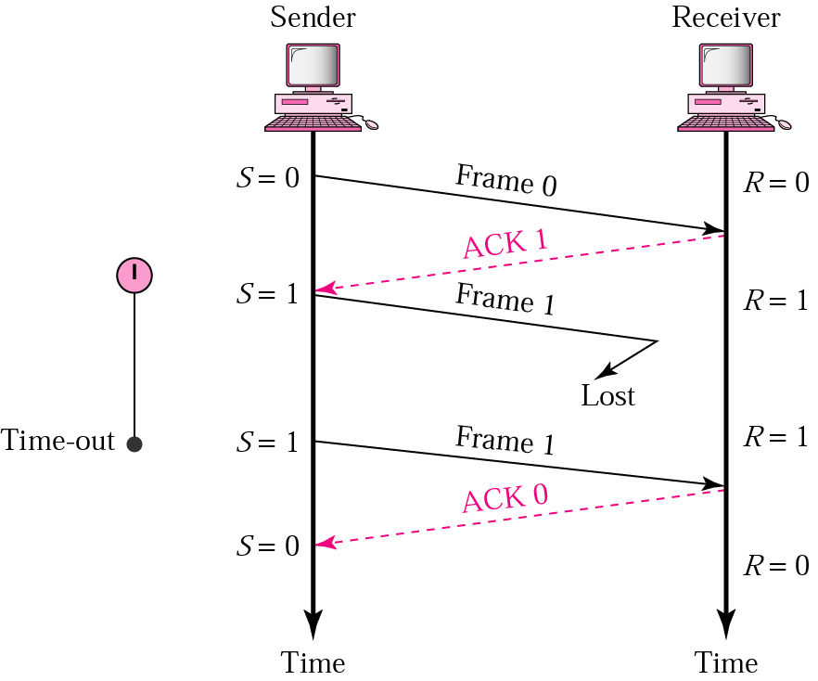
11.2 Stop-and-Wait ARQ, lost frame

Slide 9
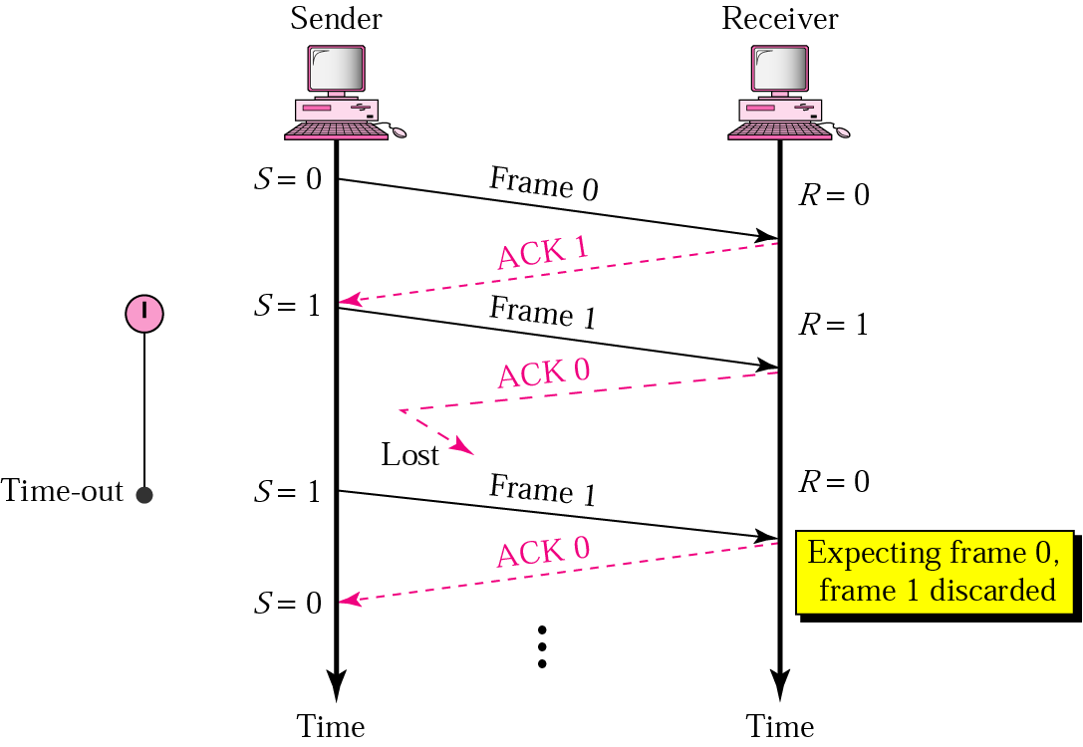
11.3 Stop-and-Wait ARQ, lost ACK frame

Slide 10
Note:
In Stop-and-Wait ARQ, numbering frames prevents the retaining of duplicate frames.

Slide 11
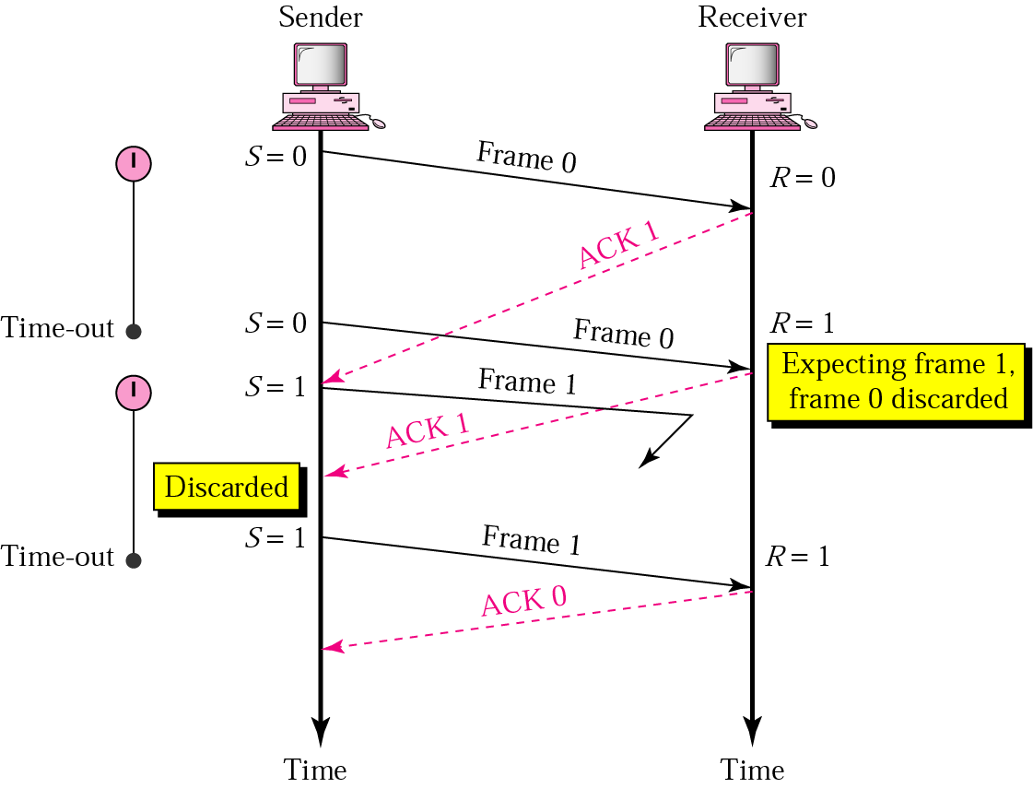
11.4 Stop-and-Wait ARQ, delayed ACK

Slide 12
Note:
Numbered acknowledgments are needed if an acknowledgment is delayed and the next frame is lost.

Slide 13
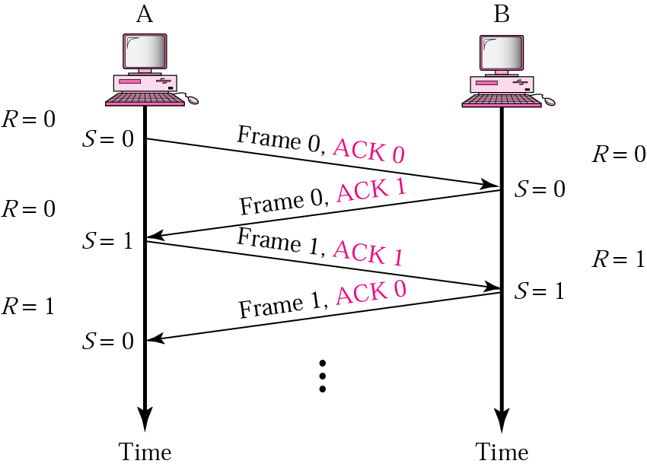
11.5 Piggybacking

Slide 14
Go-Back-N ARQ
Sequence Number
Sender and Receiver Sliding Window
Control Variables and Timers
Acknowledgment
Resending Frames
Operation

Slide 15
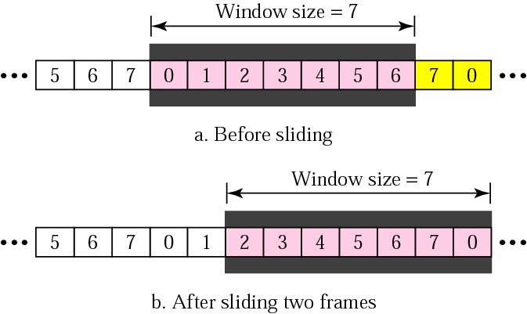
11.6 Sender sliding window

Slide 16
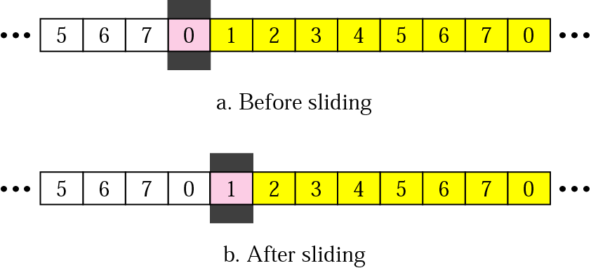
11.7 Receiver sliding window

Slide 17
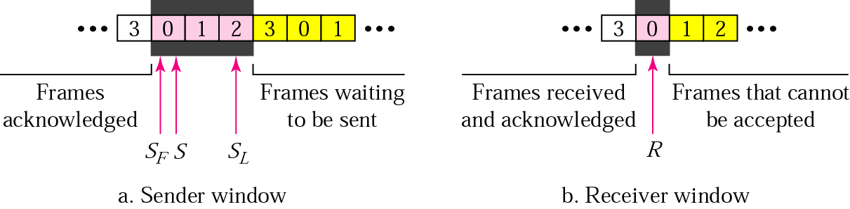
11.8 Control variables

Slide 18
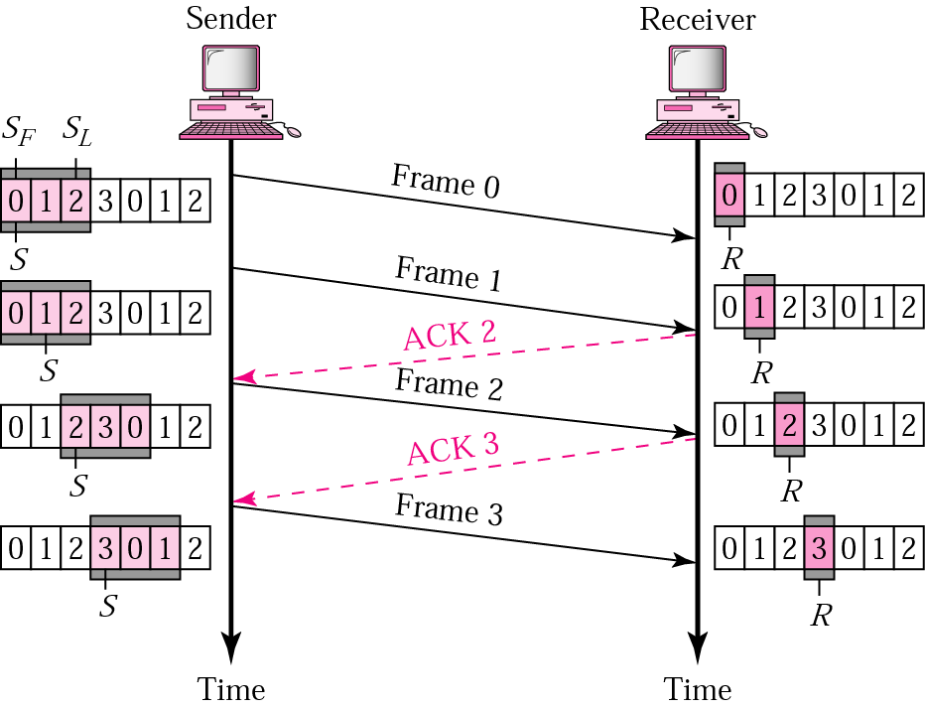
11.9 Go-Back-N ARQ, normal operation

Slide 19
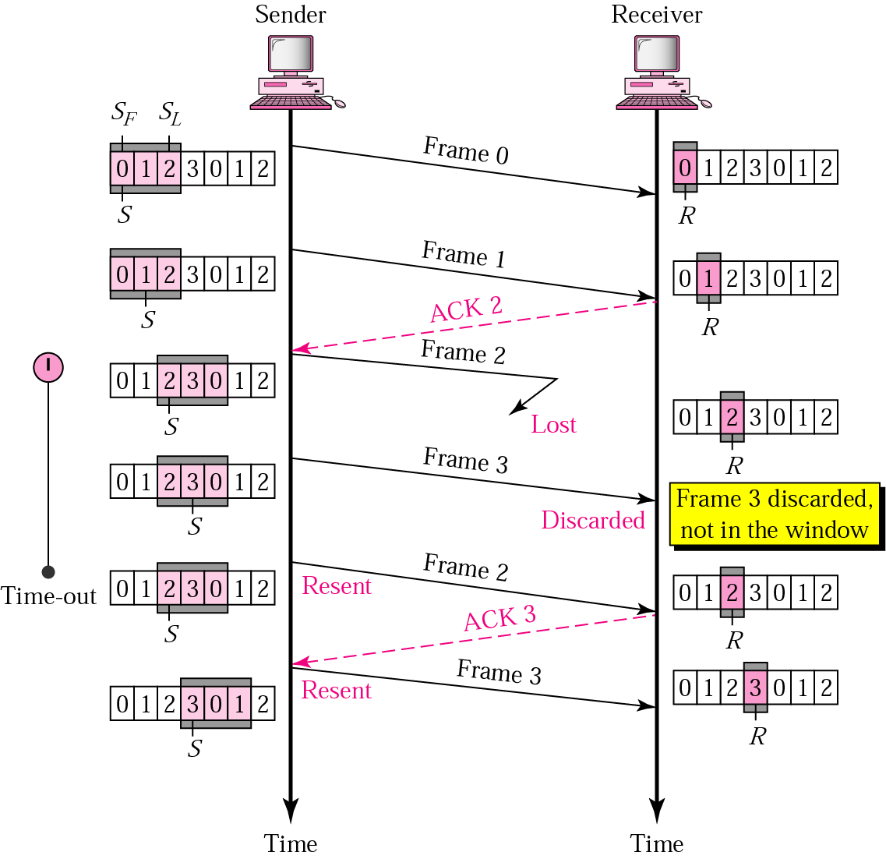
11.10 Go-Back-N ARQ, lost frame

Slide 20
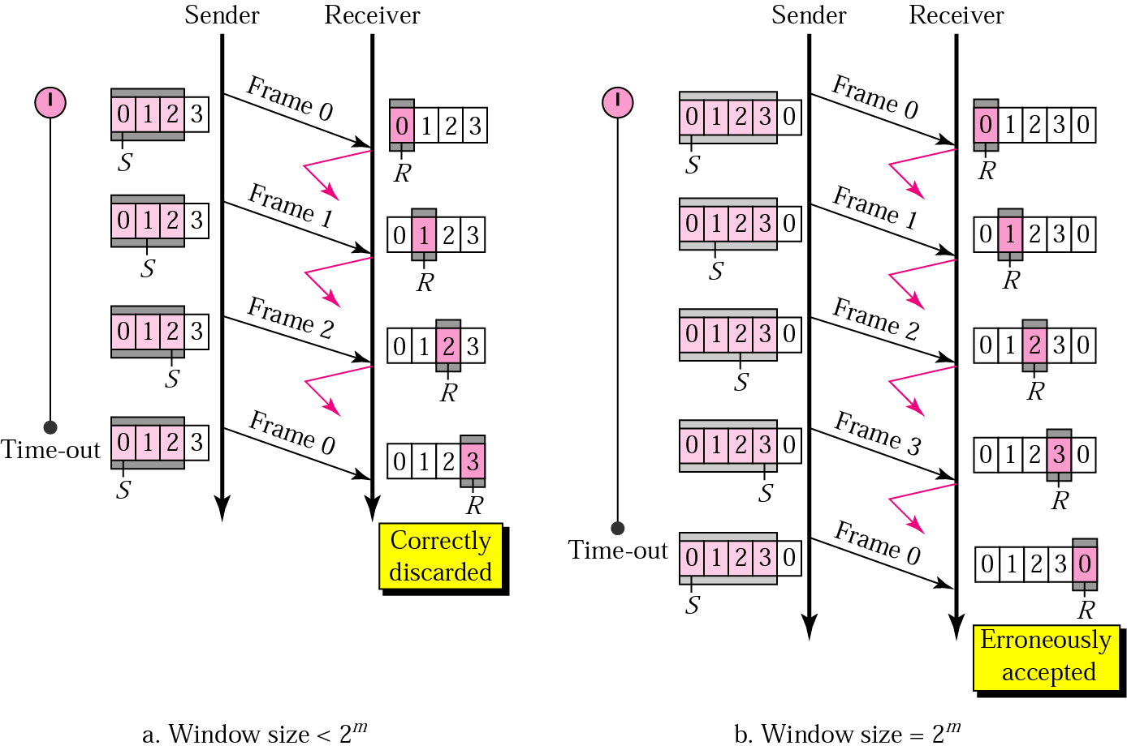
11.11 Go-Back-N ARQ: sender window size

Slide 21
Note:
In Go-Back-N ARQ, the size of the sender window must be less than 2m; the size of the receiver window is always 1.

Slide 22
Selective-Repeat ARQ
Sender and Receiver Windows
Operation
Sender Window Size
Bidirectional Transmission
Pipelining

Slide 23
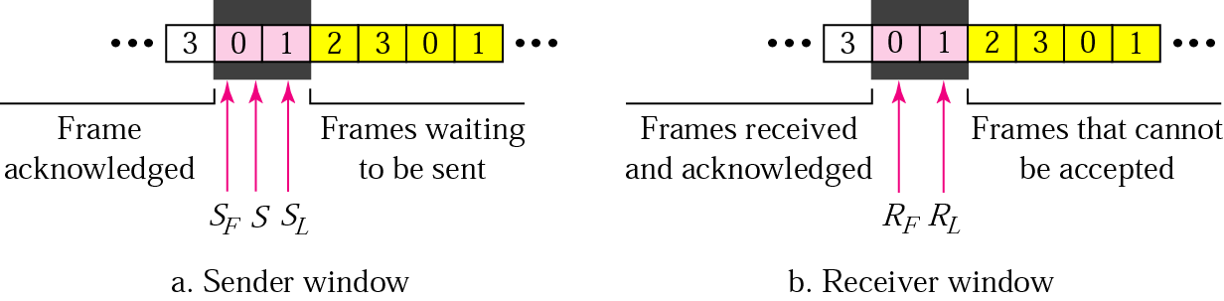
11.12 Selective Repeat ARQ, sender and receiver windows

Slide 24
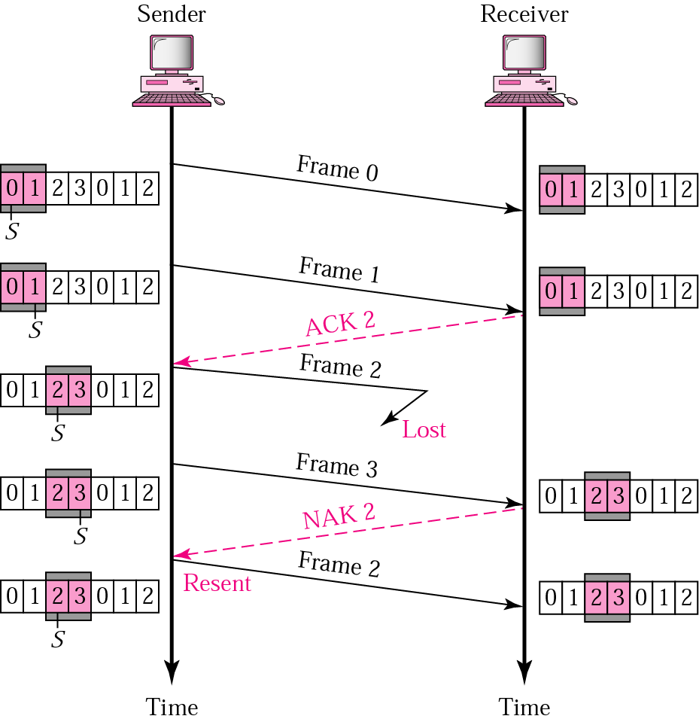
11.13 Selective Repeat ARQ, lost frame

Slide 25
Note:
In Selective Repeat ARQ, the size of the sender and receiver window must be at most one-half of 2^{m}.

Slide 26
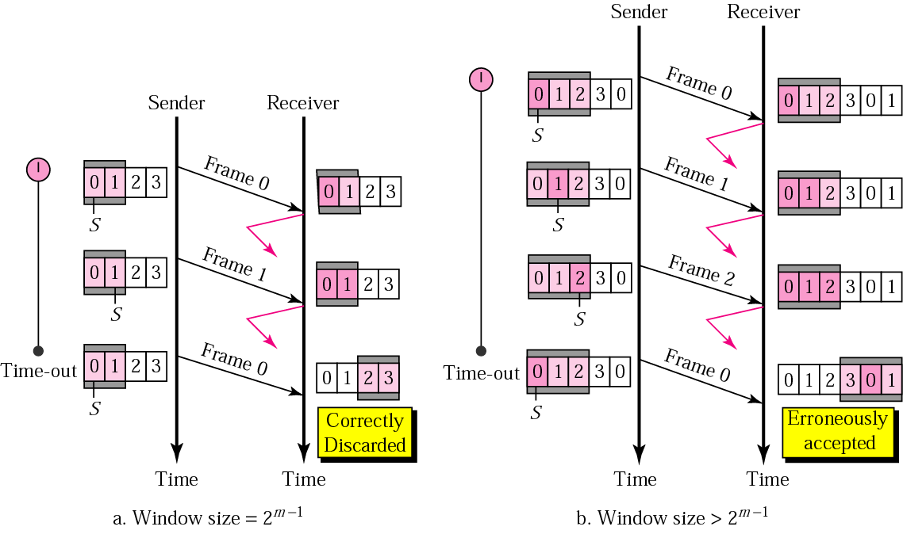
11.14 Selective Repeat ARQ, sender window size

Slide 27
Example 1
In a Stop-and-Wait ARQ system, the bandwidth of the line is 1 Mbps, and 1 bit takes 20 ms to make a round trip. What is the bandwidth-delay product? If the system data frames are 1000 bits in length, what is the utilization percentage of the link?
Solution
The bandwidth-delay product is
1 × 10⁶ × 20 × 10⁻³ = 20,000 bits
The system can send 20,000 bits during the time it takes for the data to go from the sender to the receiver and then back again. However, the system sends only 1000 bits. We can say that the link utilization is only 1000/20,000, or 5%. For this reason, for a link with high bandwidth or long delay, use of Stop-and-Wait ARQ wastes the capacity of the link.

Slide 28
Example 2
What is the utilization percentage of the link in Example 1 if the link uses Go-Back-N ARQ with a 15-frame sequence?
Solution
The bandwidth-delay product is still 20,000. The system can send up to 15 frames or 15,000 bits during a round trip. This means the utilization is 15,000/20,000, or 75 percent. Of course, if there are damaged frames, the utilization percentage is much less because frames have to be resent.

Slide 29
HDLC
Configurations and Transfer Modes
Frames
Frame Format
Examples
Data Transparency

Slide 30
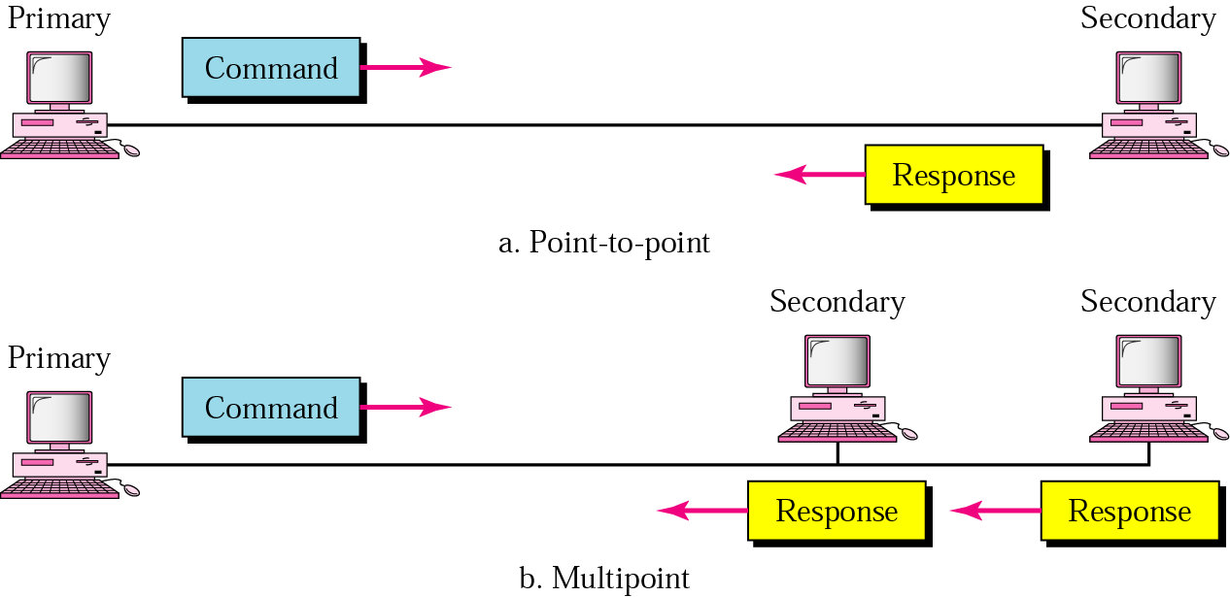
11.15 NRM

Slide 31
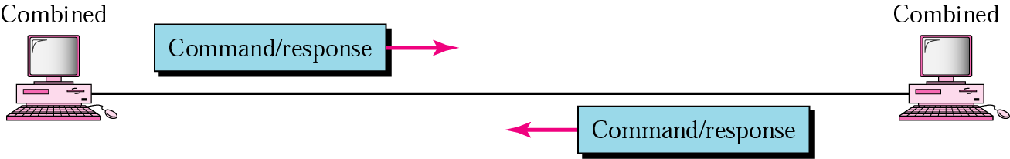
11.16 ABM

Slide 32
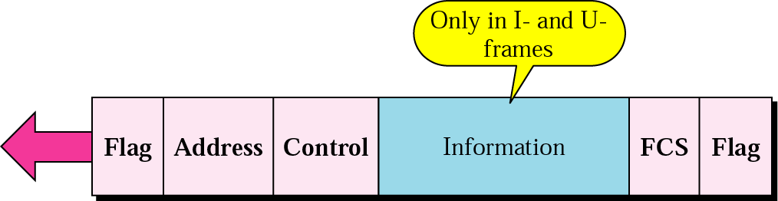
11.17 HDLC frame

Slide 33
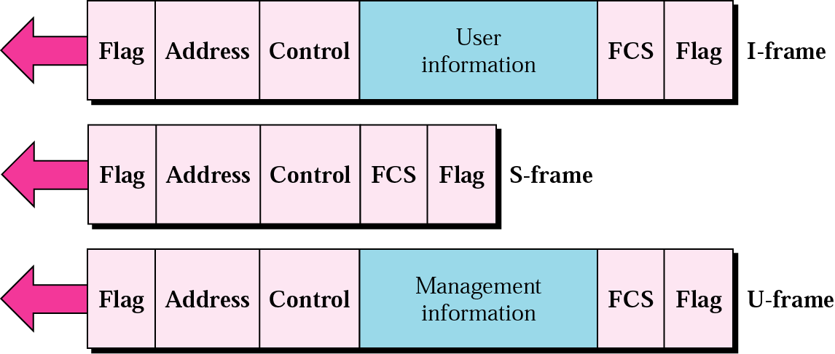
11.18 HDLC frame types

Slide 34
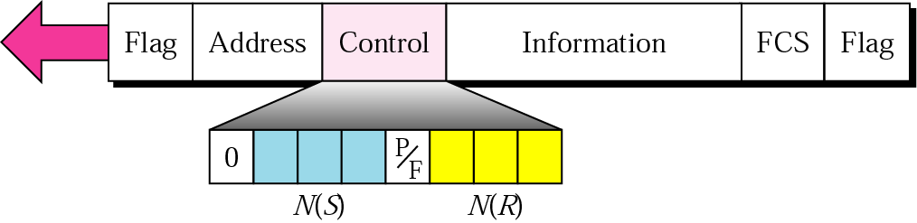
11.19 I-frame

Slide 35
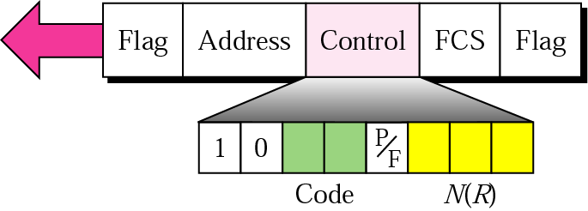
11.20 S-frame control field in HDLC
RR Receiver ready
RNR Receiver not ready
REJ Reject
SREJ Selective reject

Slide 36
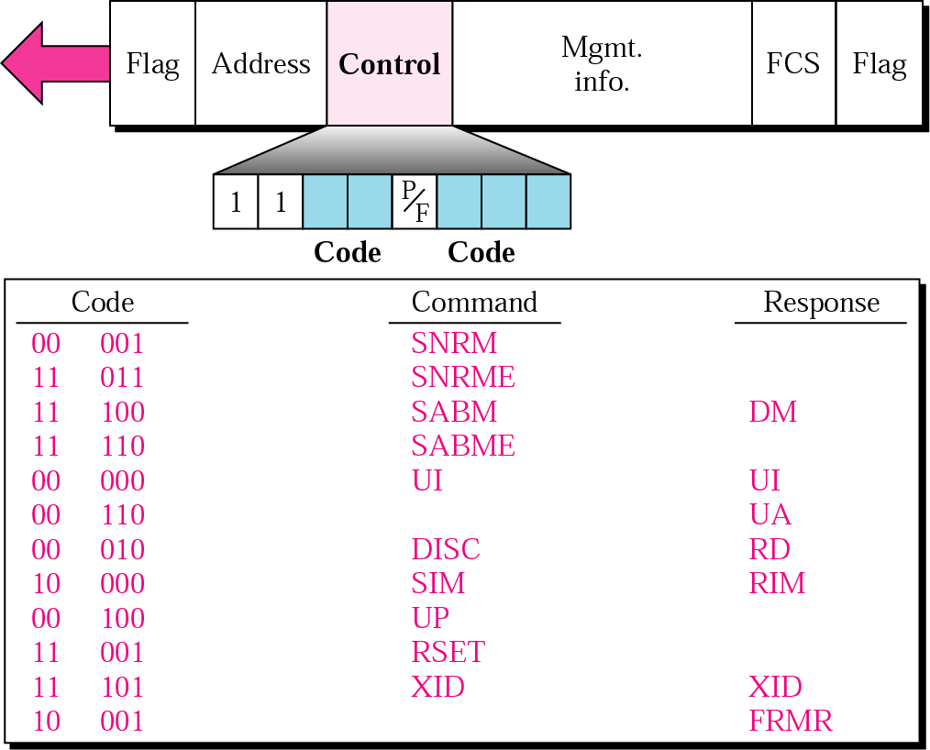
11.21 U-frame control field in HDLC

Slide 37
Table 11.1 U-frame control command and response
Command/response | Meaning
SNRM | Set normal response mode
SNRME | Set normal response mode (extended)
SABM | Set asynchronous balanced mode
SABME | Set asynchronous balanced mode (extended)
UP | Unnumbered poll
UI | Unnumbered information
UA | Unnumbered acknowledgment
RD | Request disconnect
DISC | Disconnect
DM | Disconnect mode
RIM | Request information mode
SIM | Set initialization mode
RSET | Reset
XID | Exchange ID
FRMR | Frame reject

Slide 38
Example 3
Figure 11.22 shows an exchange using piggybacking where is no error.
Station A begins the exchange of information with an I-frame numbered 0 followed by another I-frame numbered 1.
Station B piggybacks its acknowledgment of both frames onto an I-frame of its own. Station B’s first I-frame is also numbered 0 [N(S) field] and contains a 2 in its N(R) field, acknowledging the receipt of A’s frames 1 and 0 and indicating that it expects frame 2 to arrive next.
Station B transmits its second and third I-frames (numbered 1 and 2) before accepting further frames from station A. Its N(R) information, therefore, has not changed: B frames 1 and 2 indicate that station B is still expecting A frame 2 to arrive next.

Slide 39
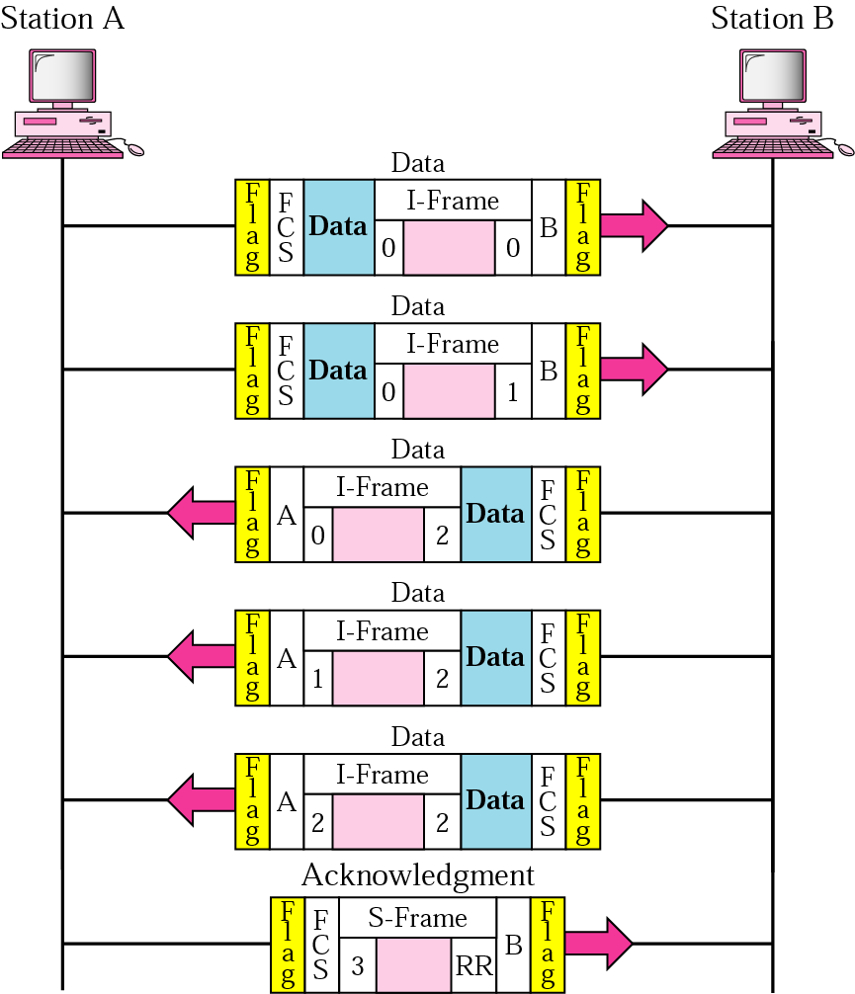
11.22 Example 3

Slide 40
Example 4
In Example 3, suppose frame 1 sent from station B to station A has an error. Station A informs station B to resend frames 1 and 2 (the system is using the Go-Back-N mechanism). Station A sends a reject supervisory frame to announce the error in frame 1. Figure 11.23 shows the exchange.

Slide 41
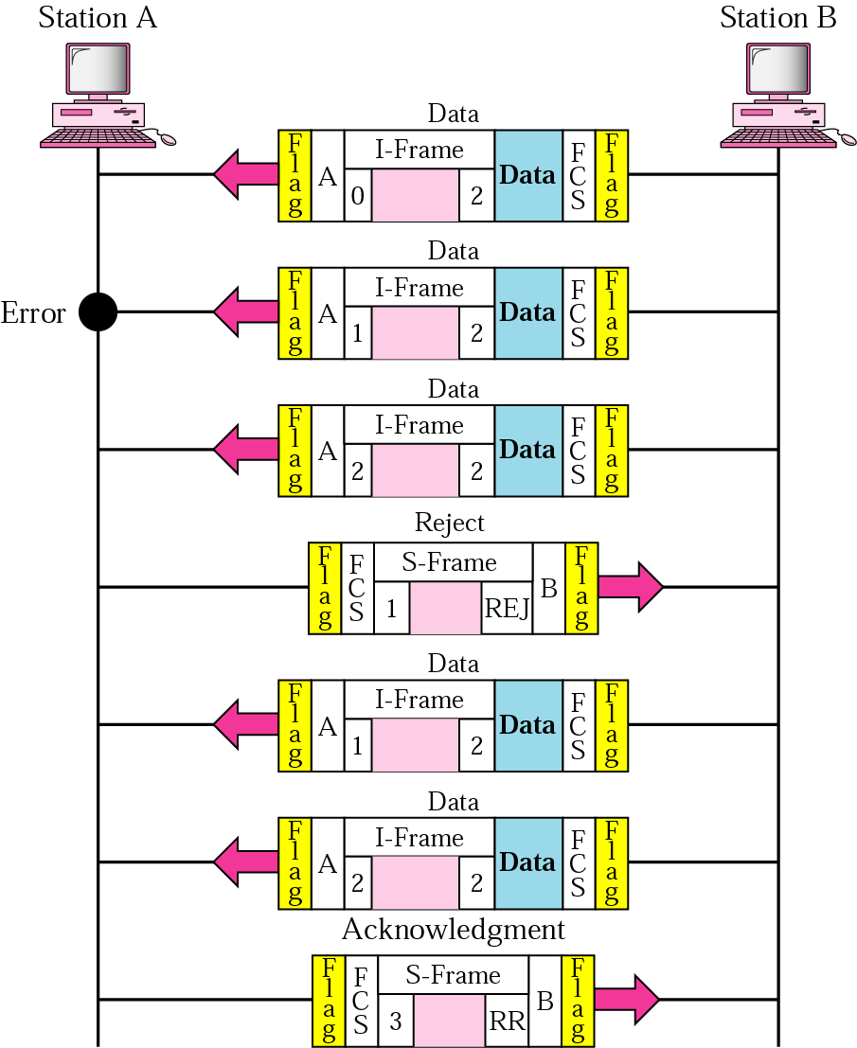
11.23 Example 4

Slide 42
Note:
Bit stuffing is the process of adding one extra 0 whenever there are five consecutive 1s in the data so that the receiver does not mistake the
data for a flag.

Slide 43
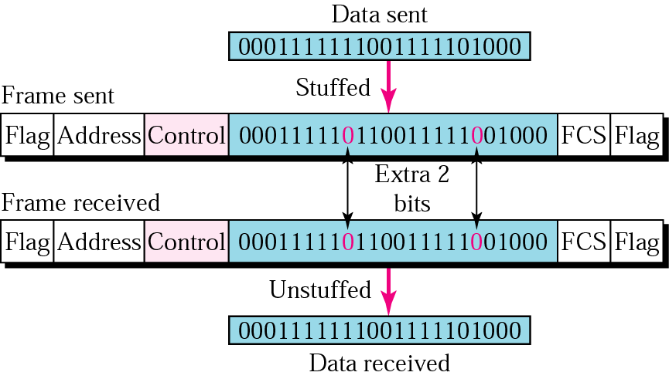
11.24 Bit stuffing and removal

Slide 44
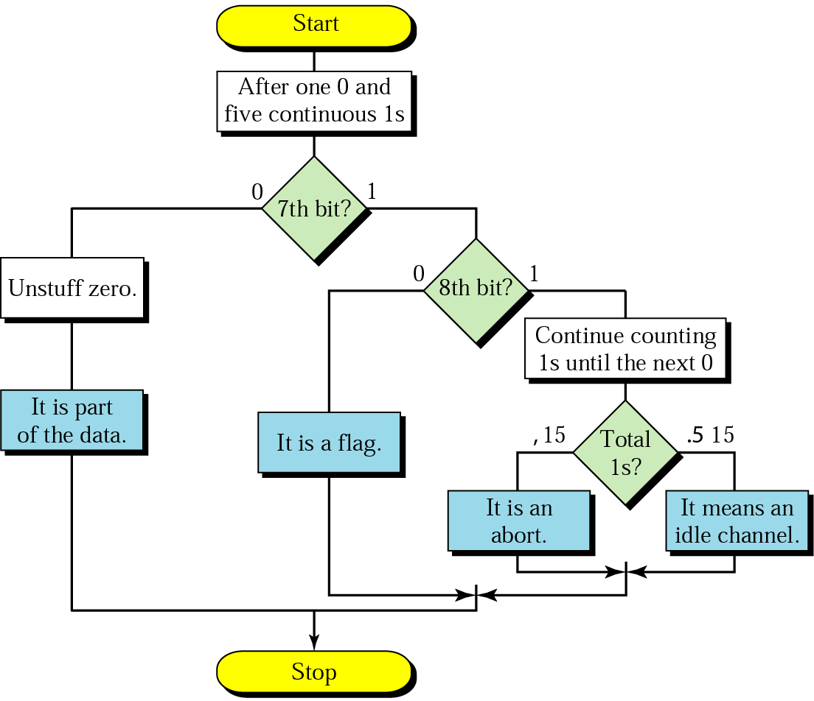
11.25 Bit stuffing in HDLC

